Slide 1
LVMs for Dimensionality Reduction
CS771: Introduction to Machine Learning
Piyush Rai

Slide 2
Plan
2
A latent variable model for dimensionality reduction
Probabilistic PCA
Expectation maximization (EM) algorithm for MLE for PPCA

Slide 3
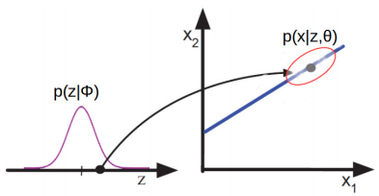








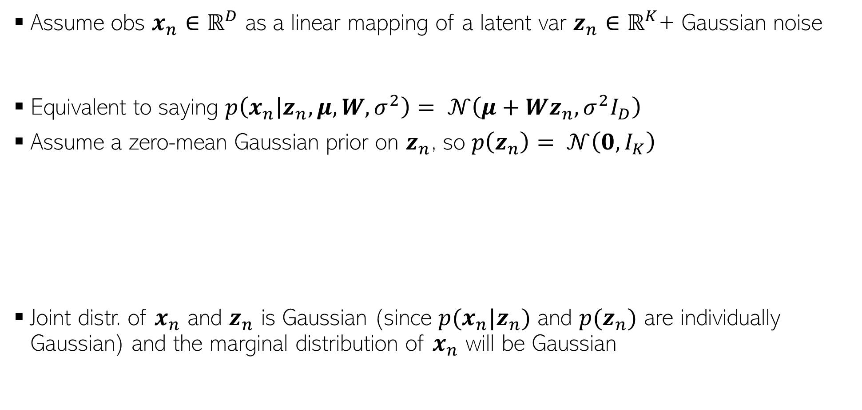
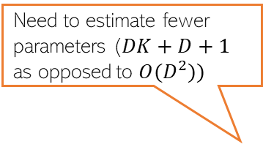
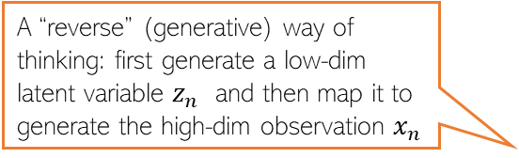
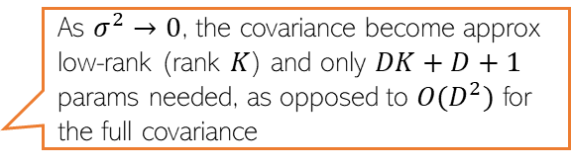
Probabilistic PCA (PPCA)
3
Assume obs $x_{n}∈ℝ^{D}$ as a linear mapping of a latent var $z_{n}∈ℝ^{K}$+ Gaussian noise
Equivalent to saying $p\left(x_{n} | z_{n}, μ, W,σ^{2}\right)= 𝒩\left(μ+Wz_{n},σ^{2}I_{D}\right)$
Assume a zero-mean Gaussian prior on $z_{n}$, so $p\left(z_{n}\right)= 𝒩\left(0, I_{K}\right)$
Joint distr. of $x_{n}$ and $z_{n}$ is Gaussian (since $p(x_{n}|z_{n})$ and $p(z_{n})$ are individually Gaussian) and the marginal distribution of $x_{n}$ will be Gaussian
$D×1$ offset
$D× K$matrix
Drawn from a zero-mean $D$-dim Gaussian $𝒩\left(0,σ^{2}I_{D}\right)$
$$x_{n}=μ+Wz_{n}+ε_{n}$$
Need to estimate fewer parameters ($DK+D+1$ as opposed to $O(D^{2}))$
A “reverse” (generative) way of thinking: first generate a low-dim latent variable $z_{n}$ and then map it to generate the high-dim observation $x_{n}$
$$Wz$$
$x∈$ $ℝ^{2}$
$$μ$$
Thus PPCA does a low-rank approximation of the covariance matrix
$z∈$ $ℝ$
As $σ^{2}→0$, the covariance become approx low-rank (rank $K$) and only $DK+D+1$ params needed, as opposed to $O(D^{2})$ for the full covariance
$$p\left(x_{n} | W,σ^{2}\right)=N\left(x_{n} | μ,WW^{⊤}+σ^{2}I_{D}\right)$$

Slide 4
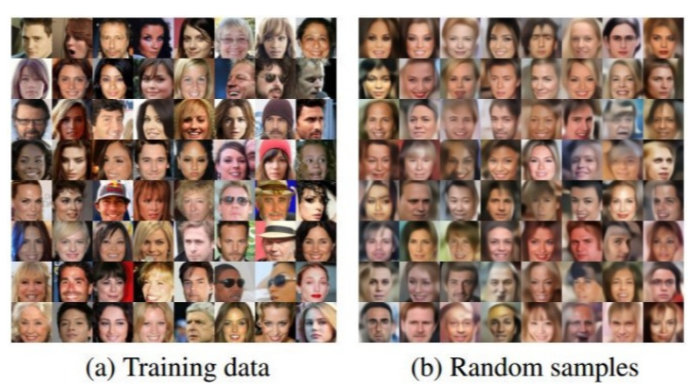

Benefits of Generative Models for Dim-Red
One benefit: Once model parameters are learned, we can even generate new data, e.g.,
Generate a random $z_{n}$ from $𝒩\left(0, I_{K}\right)$
Generate $x_{n}$ condition on $z_{n}$ from $𝒩\left(μ+Wz_{n},σ^{2}I_{D}\right)$
Many other benefits. For example, can do dim-red, even if $x_{n}$ has part of it as missing.
Generated using a more sophisticated generative model, not PPCA (but similar in formulation)

Slide 5


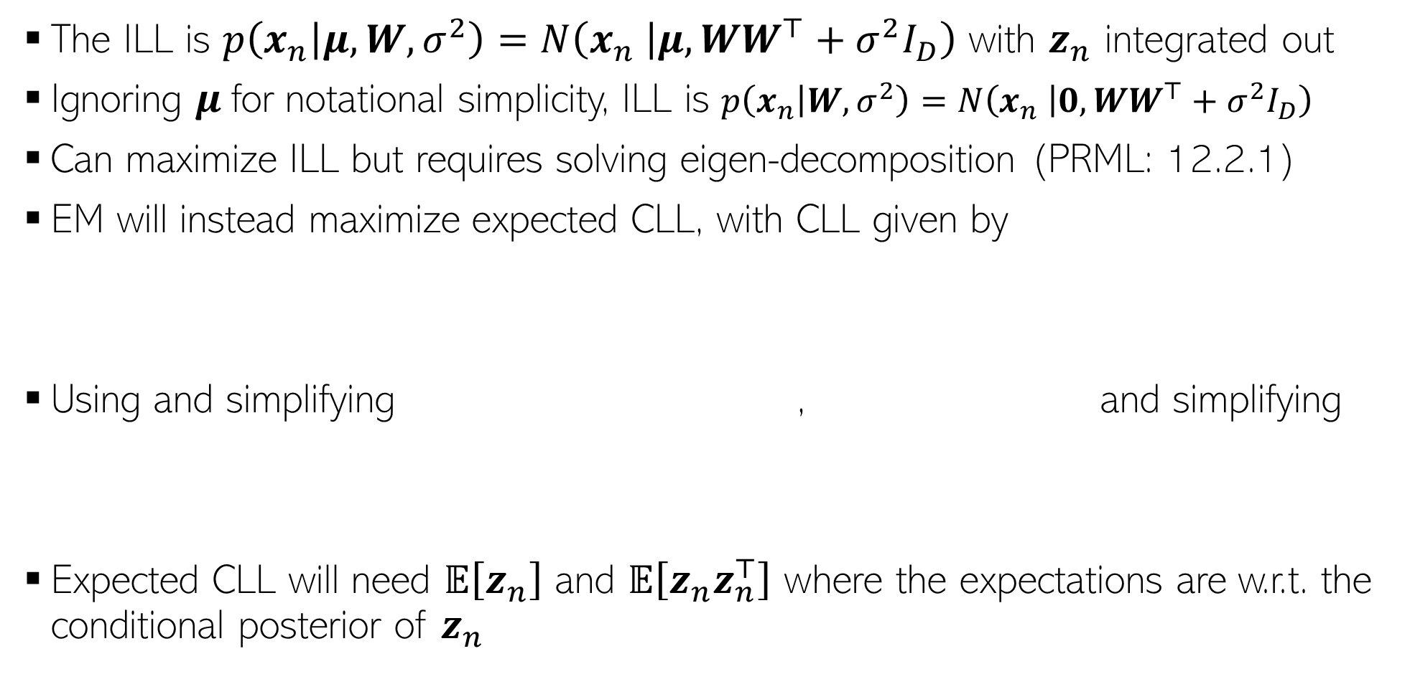
Learning PPCA using EM
The ILL is $p\left(x_{n} | μ, W,σ^{2}\right)=N\left(x_{n} | μ,WW^{⊤}+σ^{2}I_{D}\right)$ with $z_{n}$ integrated out
Ignoring $μ$for notational simplicity, ILL is $p\left(x_{n} | W,σ^{2}\right)=N\left(x_{n} | 0,WW^{⊤}+σ^{2}I_{D}\right)$
Can maximize ILL but requires solving eigen-decomposition (PRML: 12.2.1)
EM will instead maximize expected CLL, with CLL given by
Using and simplifying , and simplifying
Expected CLL will need $𝔼\left[z_{n}\right]$ and $𝔼\left[z_{n}z_{n}^{⊤}\right]$ where the expectations are w.r.t. the conditional posterior of $z_{n}$

Slide 6
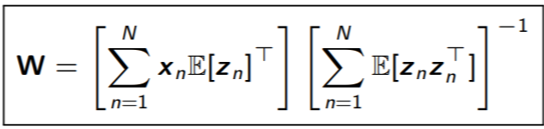
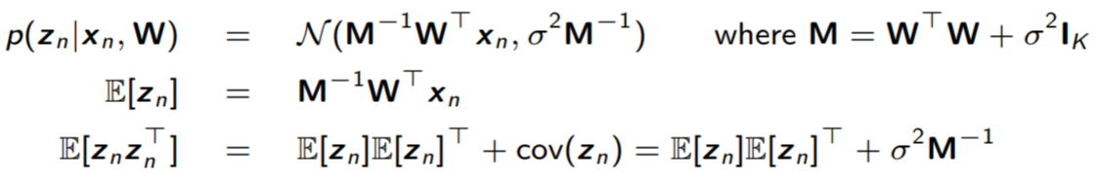
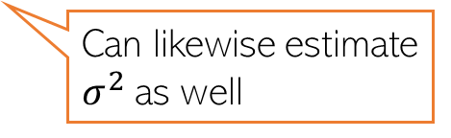

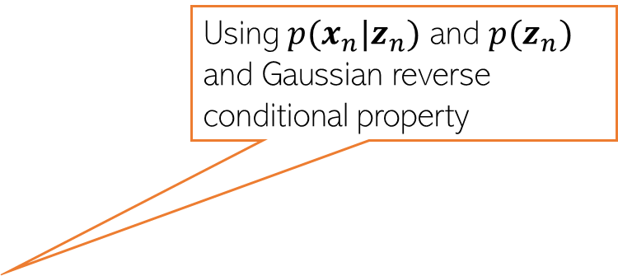

Learning PPCA using EM
Using $p(x_{n}|z_{n})$ and $p(z_{n})$ and Gaussian reverse conditional property
Ignoring the $μ$parameter
The EM algo for PPCA alternates between two steps
Compute conditional posterior of $z_{n}$given parameters $Θ = (W,σ^{2})$
Maximize the expected CLL $𝔼\left[log p(X,Z|W,σ^{2})\right]$ w.r.t. $Θ$
Taking derivative of expected CLL w.r.t. $W$ and setting to zero gives
Required expectations can be found from the conditional posterior of $z_{n}$
Can likewise estimate $σ^{2}$as well

Slide 7
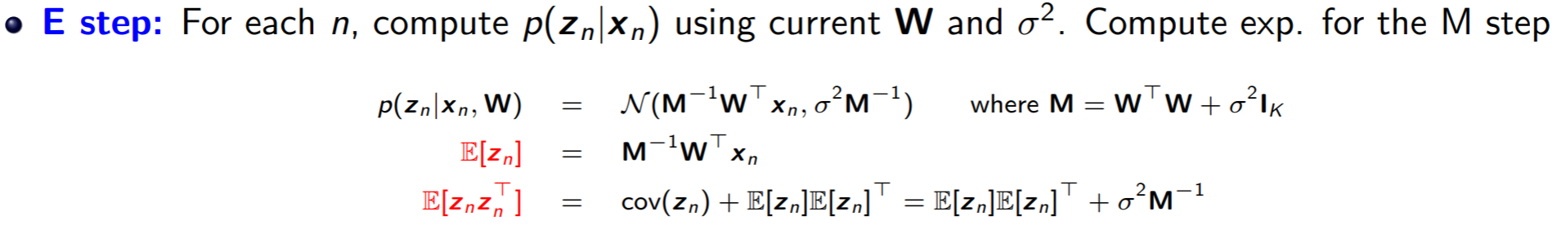
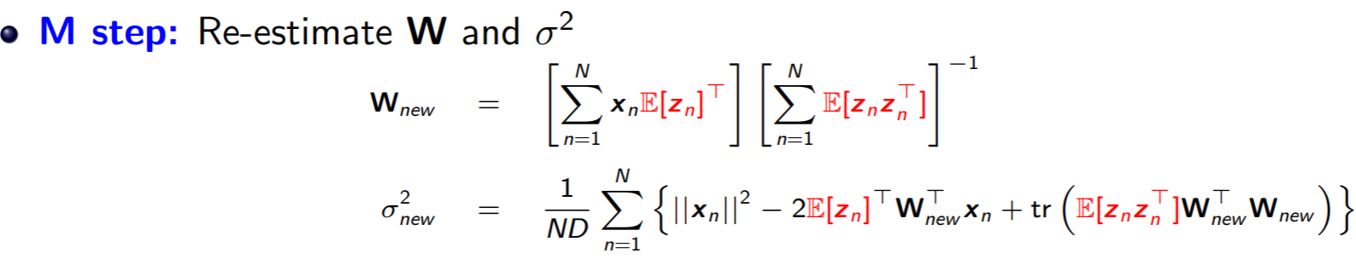
Full EM algo for PPCA

Slide 8
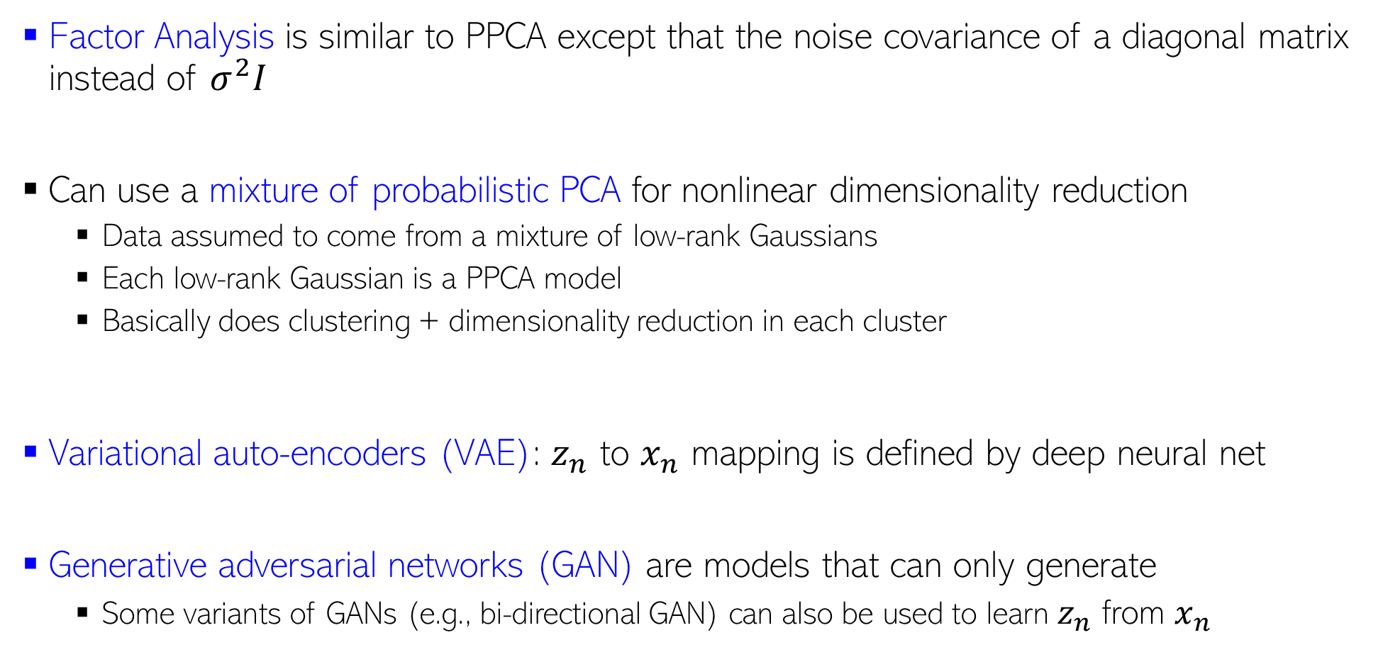
Other Generative Models for Dim-Red
Factor Analysis is similar to PPCA except that the noise covariance of a diagonal matrix instead of $σ^{2}I$
Can use a mixture of probabilistic PCA for nonlinear dimensionality reduction
Data assumed to come from a mixture of low-rank Gaussians
Each low-rank Gaussian is a PPCA model
Basically does clustering + dimensionality reduction in each cluster
Variational auto-encoders (VAE): $z_{n}$ to $x_{n}$ mapping is defined by deep neural net
Generative adversarial networks (GAN) are models that can only generate
Some variants of GANs (e.g., bi-directional GAN) can also be used to learn $z_{n}$ from $x_{n}$
Will look at VAE and GAN briefly when talking about deep learning

Slide 9
Coming up next
Deep neural networks

